Slide 1
Pranking with IoT
Hack or be hacked

Slide 2
Learning objectives
Students will gain knowledge of how the data flow in an Internet of Things” system works
Students will reflect on “what is hacking?” and gain knowledge of different types of hackers
Students will reflect on the impact that Internet of Things has for individuals and the society
Students will reflect on the societal implications of hacking IoT systems
Students will be able to understand and use simple encryption to protect an IoT system against hacking
5

Slide 3
Hi future hackers,
I can’t reveal my true identity, but I've made this website for you so you can learn to hack your classmates and prank your teachers at the school just like I did.
However, before you start hacking, you need to know how to control lamps, speakers and other devices by using the internet. So you’re going to learn to use the Internet of Things (IoT).
If you do the assignments I’ve made for you, you’ll soon be able to control lamps, speakers, fans and other stuff in the teachers’ room. And in the process, you can hack and take over your classmates’ devices.
Have fun hacking!
Notes:
Start by showing and reading the text message from the hacker (slide 3). The message is from a fictional student in 9th grade at the school who has discovered how to hack the teachers’ room. The message is a frame and storyline for the course. The hacker has created the assignments as a guide so the students can try out IoT hacking for themselves

Slide 4
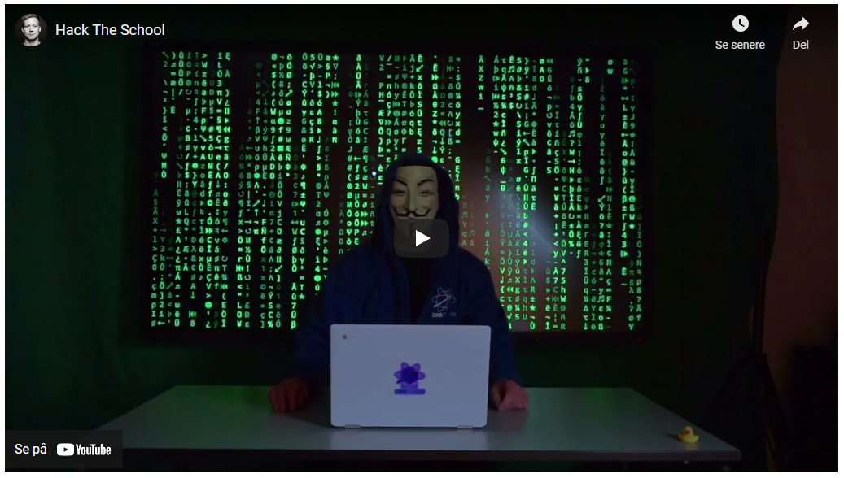
Classroom discussion
What is a hacker?
What kinds of hacking are there?
Can hacking be used for good causes? Which?
Have you ever been hacked?
Notes:
Class discussion based on the following questions: (slide 4)
What is a hacker?
What kinds of hacking are there?
Can hacking be used for good causes? What kind of good causes?
Have you ever been hacked?

Slide 5
Hacking and hackers
Notes:
Show the slides 5-13 on hacking and on kinds of hackers from the teaching presentation. This will give them an introduction to hacking and the kinds of hacking that take place

Slide 6
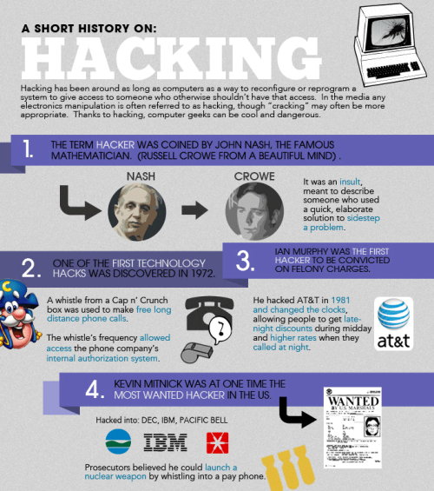
What is hacking?
There are two kinds of hacking
Hacking to optimise and change objects (or code)
Hacking as a way to use things for something other than original purpose
Notes:
Show the slides 5-13 on hacking and on kinds of hackers from the teaching presentation. This will give them an introduction to hacking and the kinds of hacking that take place

Slide 7
What is a hacker?
A hacker is often seen as a person who gaines an unauthorised access to a computer network or a digital object
A hacker breaks into a system either to cause damage or to shed light on vulnerabilities in the existing security
But there are actually six kinds of hackers
White Hat Hacker
Black hat Hacker
Grey Hat Hacker
Red Hat Hacker
Hacktivist
Script Kiddie
Notes:
Show the slides 5-13 on hacking and on kinds of hackers from the teaching presentation. This will give them an introduction to hacking and the kinds of hacking that take place

Slide 8
White Hat Hacker (Ethical Hacker)
A security hacker who gains access to systems to deal with weaknesses that have been detected
Penetration tests and weakness evaluations can also be done by a white hat hacker
Notes:
Show the slides 5-13 on hacking and on kinds of hackers from the teaching presentation. This will give them an introduction to hacking and the kinds of hacking that take place

Slide 9
Black Hat Hacker (Cracker)
A hacker who gains unauthorised access to computer systems for a personal purpose
Typically the goal is to steal data from companies, violate privacy or transfer money from bank accounts
Notes:
Show the slides 5-13 on hacking and on kinds of hackers from the teaching presentation. This will give them an introduction to hacking and the kinds of hacking that take place

Slide 10
Grey Hat Hacker
A hacker who is something between the white and black hat hacker
He or she gains access to computer systems without authorisation to find weaknesses and reveal them to the system owner
Notes:
Show the slides 5-13 on hacking and on kinds of hackers from the teaching presentation. This will give them an introduction to hacking and the kinds of hacking that take place

Slide 11
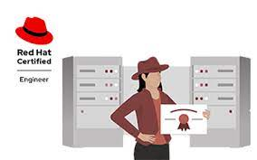
Red Hat Hacker
A red hat hacker is employed by the state to track vulnerable sites in public safety systems
Their focus is often to find and neutralize black hat hackers
Notes:
Show the slides 5-13 on hacking and on kinds of hackers from the teaching presentation. This will give them an introduction to hacking and the kinds of hacking that take place

Slide 12
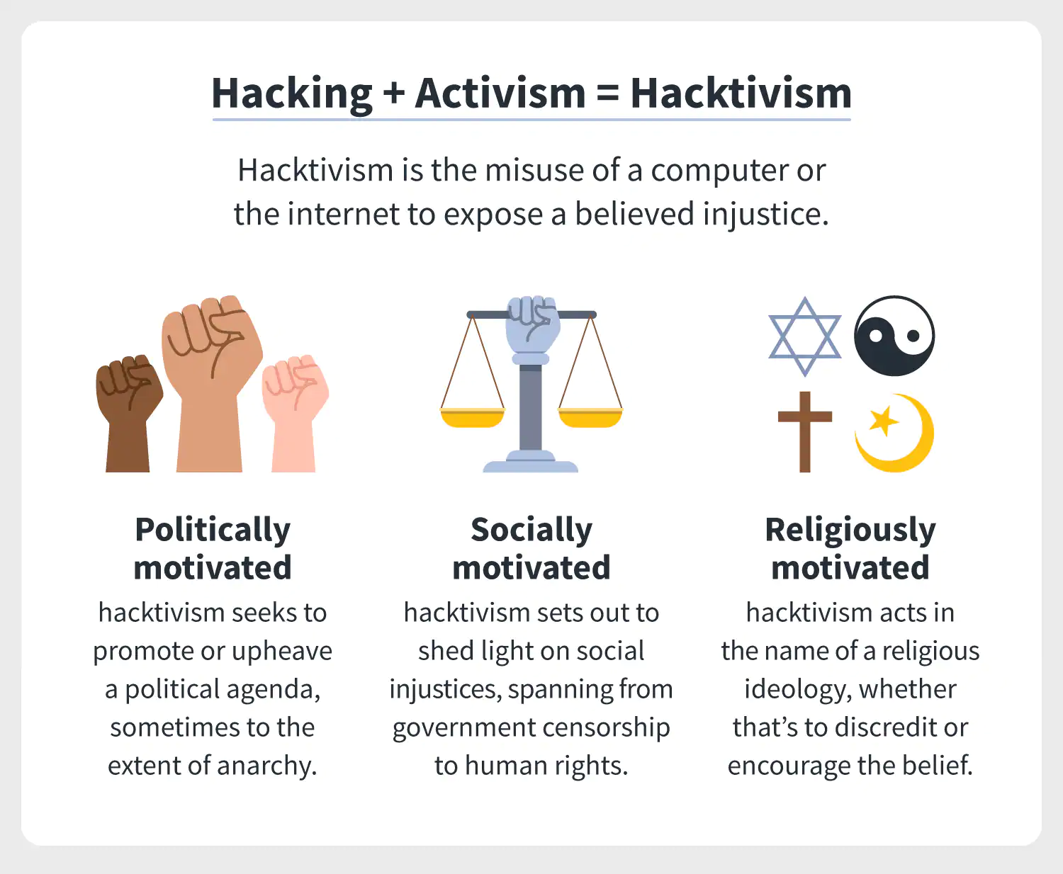
Hacktivist
A hacker who uses hacking to deliver messages about social, religious and political problems
This is normally done by gaining access to websites and uploading messages to these sites
Notes:
Show the slides 5-13 on hacking and on kinds of hackers from the teaching presentation. This will give them an introduction to hacking and the kinds of hacking that take place

Slide 13
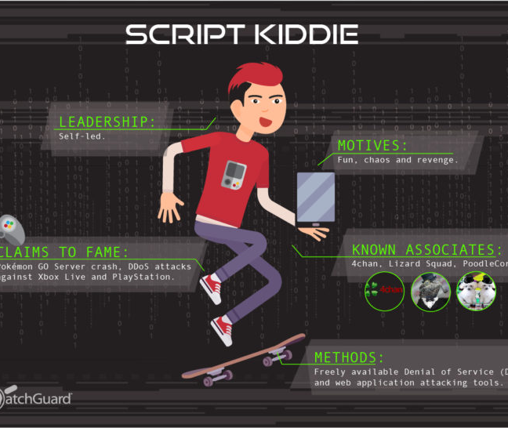
Script Kiddies
An amateur hacker who only has basic hacking skills
Script Kiddies often use hacking software provided by others
Notes:
Show the slides 5-13 on hacking and on kinds of hackers from the teaching presentation. This will give them an introduction to hacking and the kinds of hacking that take place

Slide 14
Assemble the Internet of Things kit
Notes:
Give every pair of students an IoT kit and an IoT device. Let them use the pictures in the student assignment or on slide 14-18. Alternatively, you can assemble the IoT kits with the students.
Introduce the students to the concepts: transmitter–receiver and relay

Slide 15
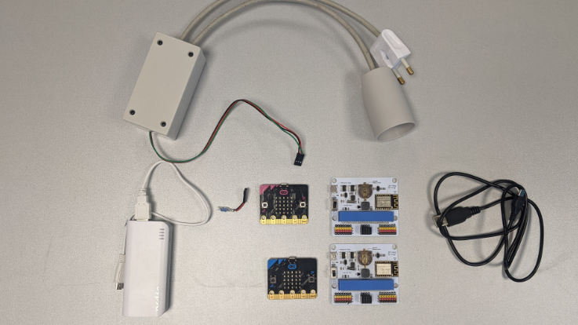
Internet of Things kit
Follow the instructions on the next slides to see how to assemble your Internet of Things kit
Notes:
Give every pair of students an IoT kit and an IoT device. Let them use the pictures in the student assignment or on slide 14-18. Alternatively, you can assemble the IoT kits with the students.
Introduce the students to the concepts: transmitter–receiver and relay

Slide 16
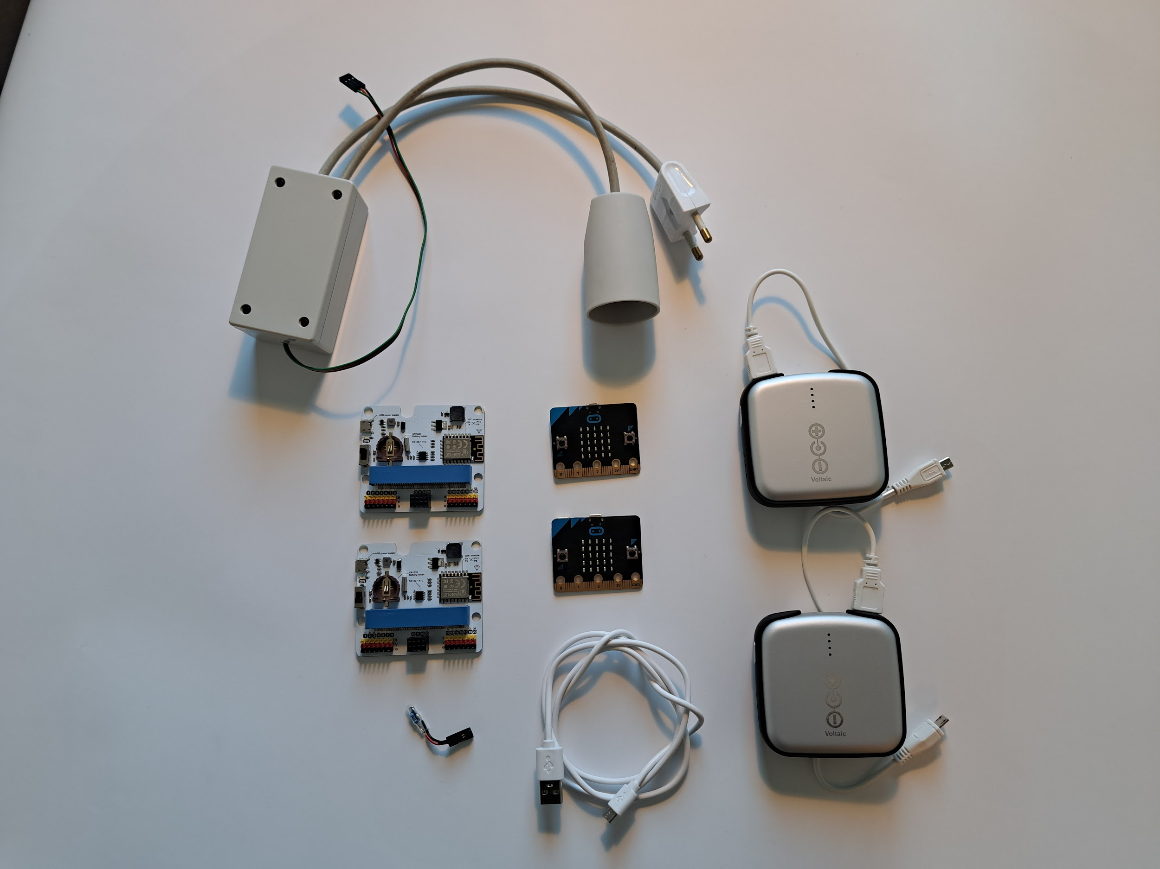
You need…
2 Micro:bits
2 IoT boards
2 power banks
1 USB cable
1 resistor
1 relay
Notes:
Give every pair of students an IoT kit and an IoT device. Let them use the pictures in the student assignment or on slide 14-18. Alternatively, you can assemble the IoT kits with the students.
Introduce the students to the concepts: transmitter–receiver and relay

Slide 17
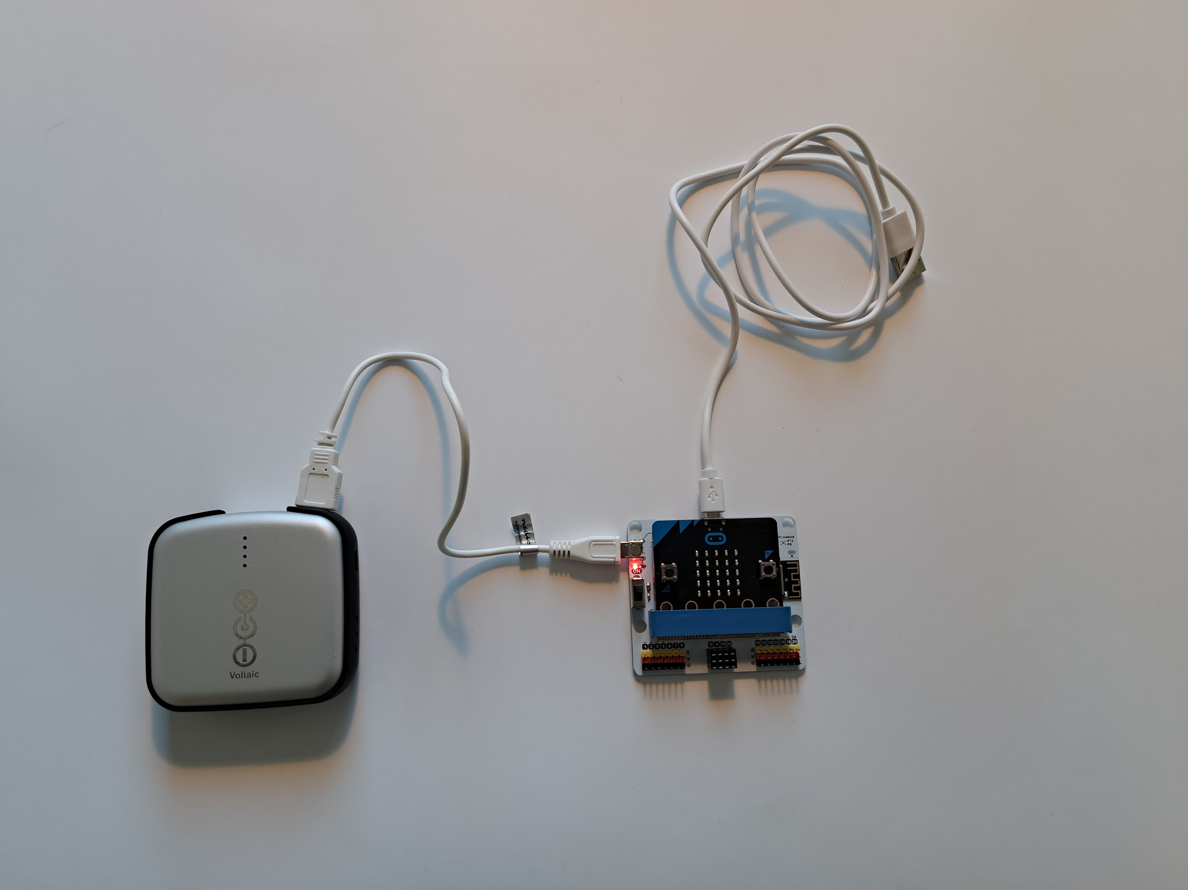
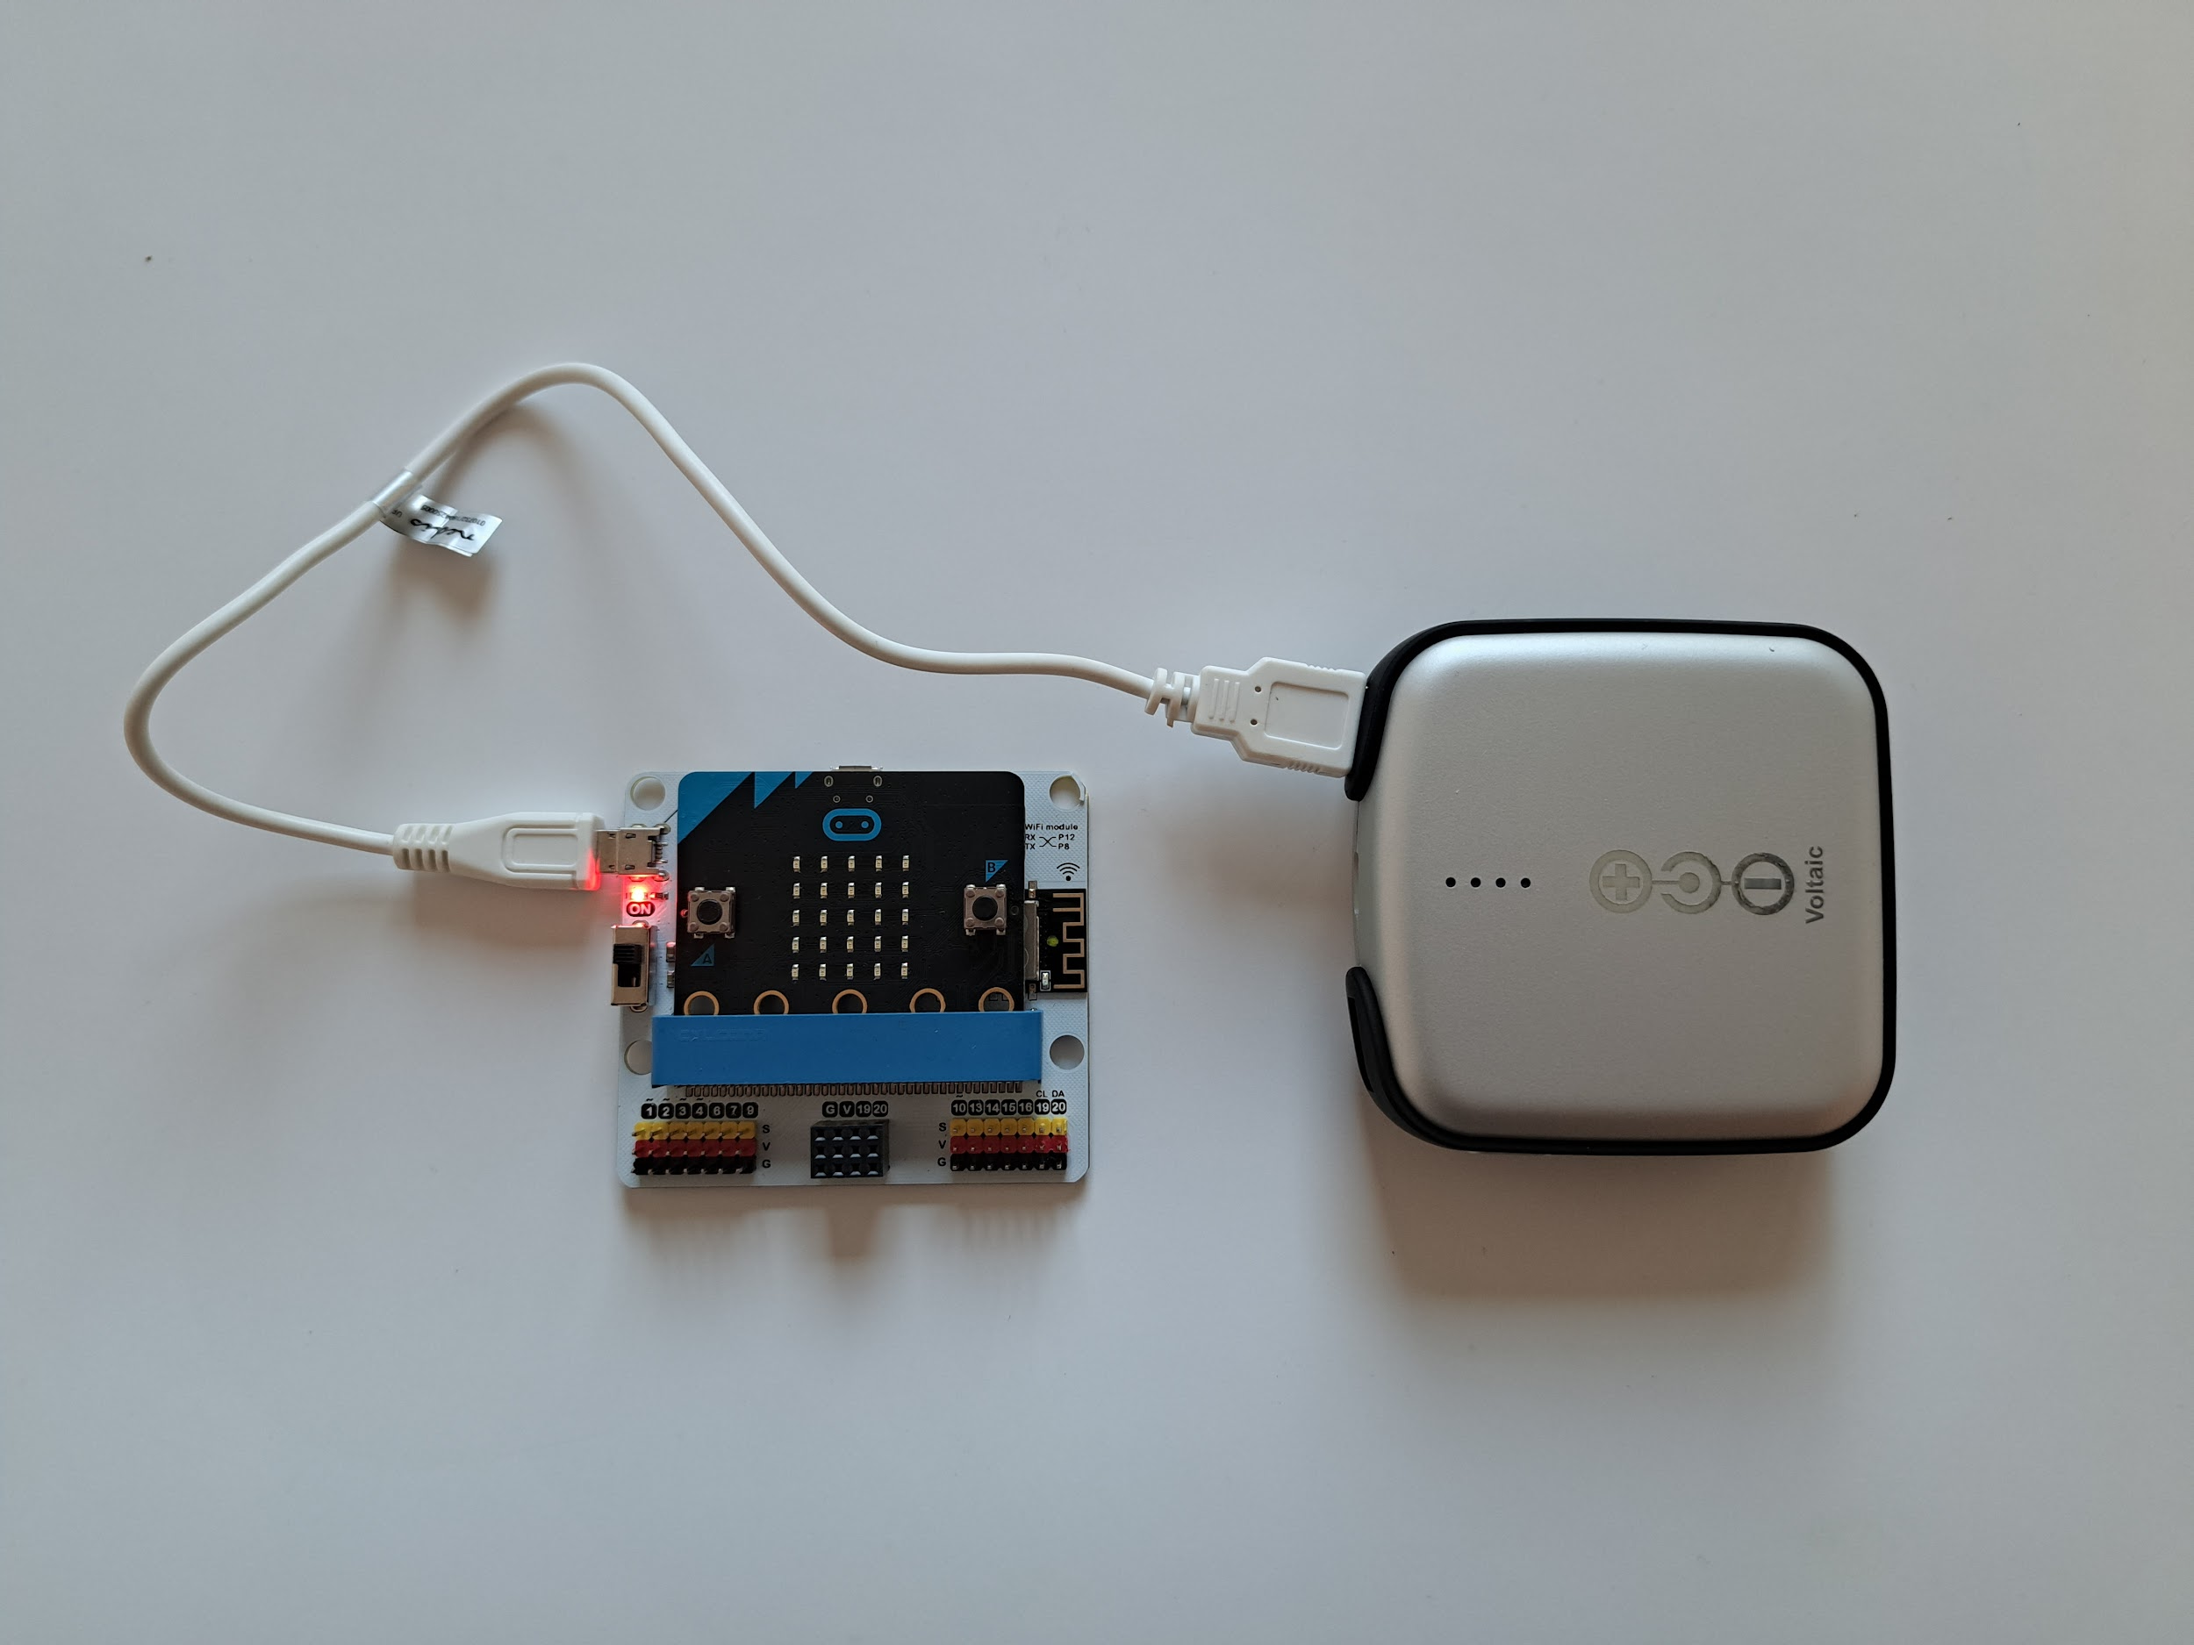
Assemble the IoT transmitter
Transmitter step 1:
Insert the micro:bit into the IoT board and connect the power bank to the IoT board
(The small red lamp should light up to show that your IoT board is turned on)
Transmitter step 2:
Transmitter step 2: Connect the USB cable into the micro:bit.
(Use the USB cable for both the transmitter and the receiver when you download the programs to the micro:bits)
Notes:
Give every pair of students an IoT kit and an IoT device. Let them use the pictures in the student assignment or on slide 14-18. Alternatively, you can assemble the IoT kits with the students.
Introduce the students to the concepts: transmitter–receiver and relay

Slide 18
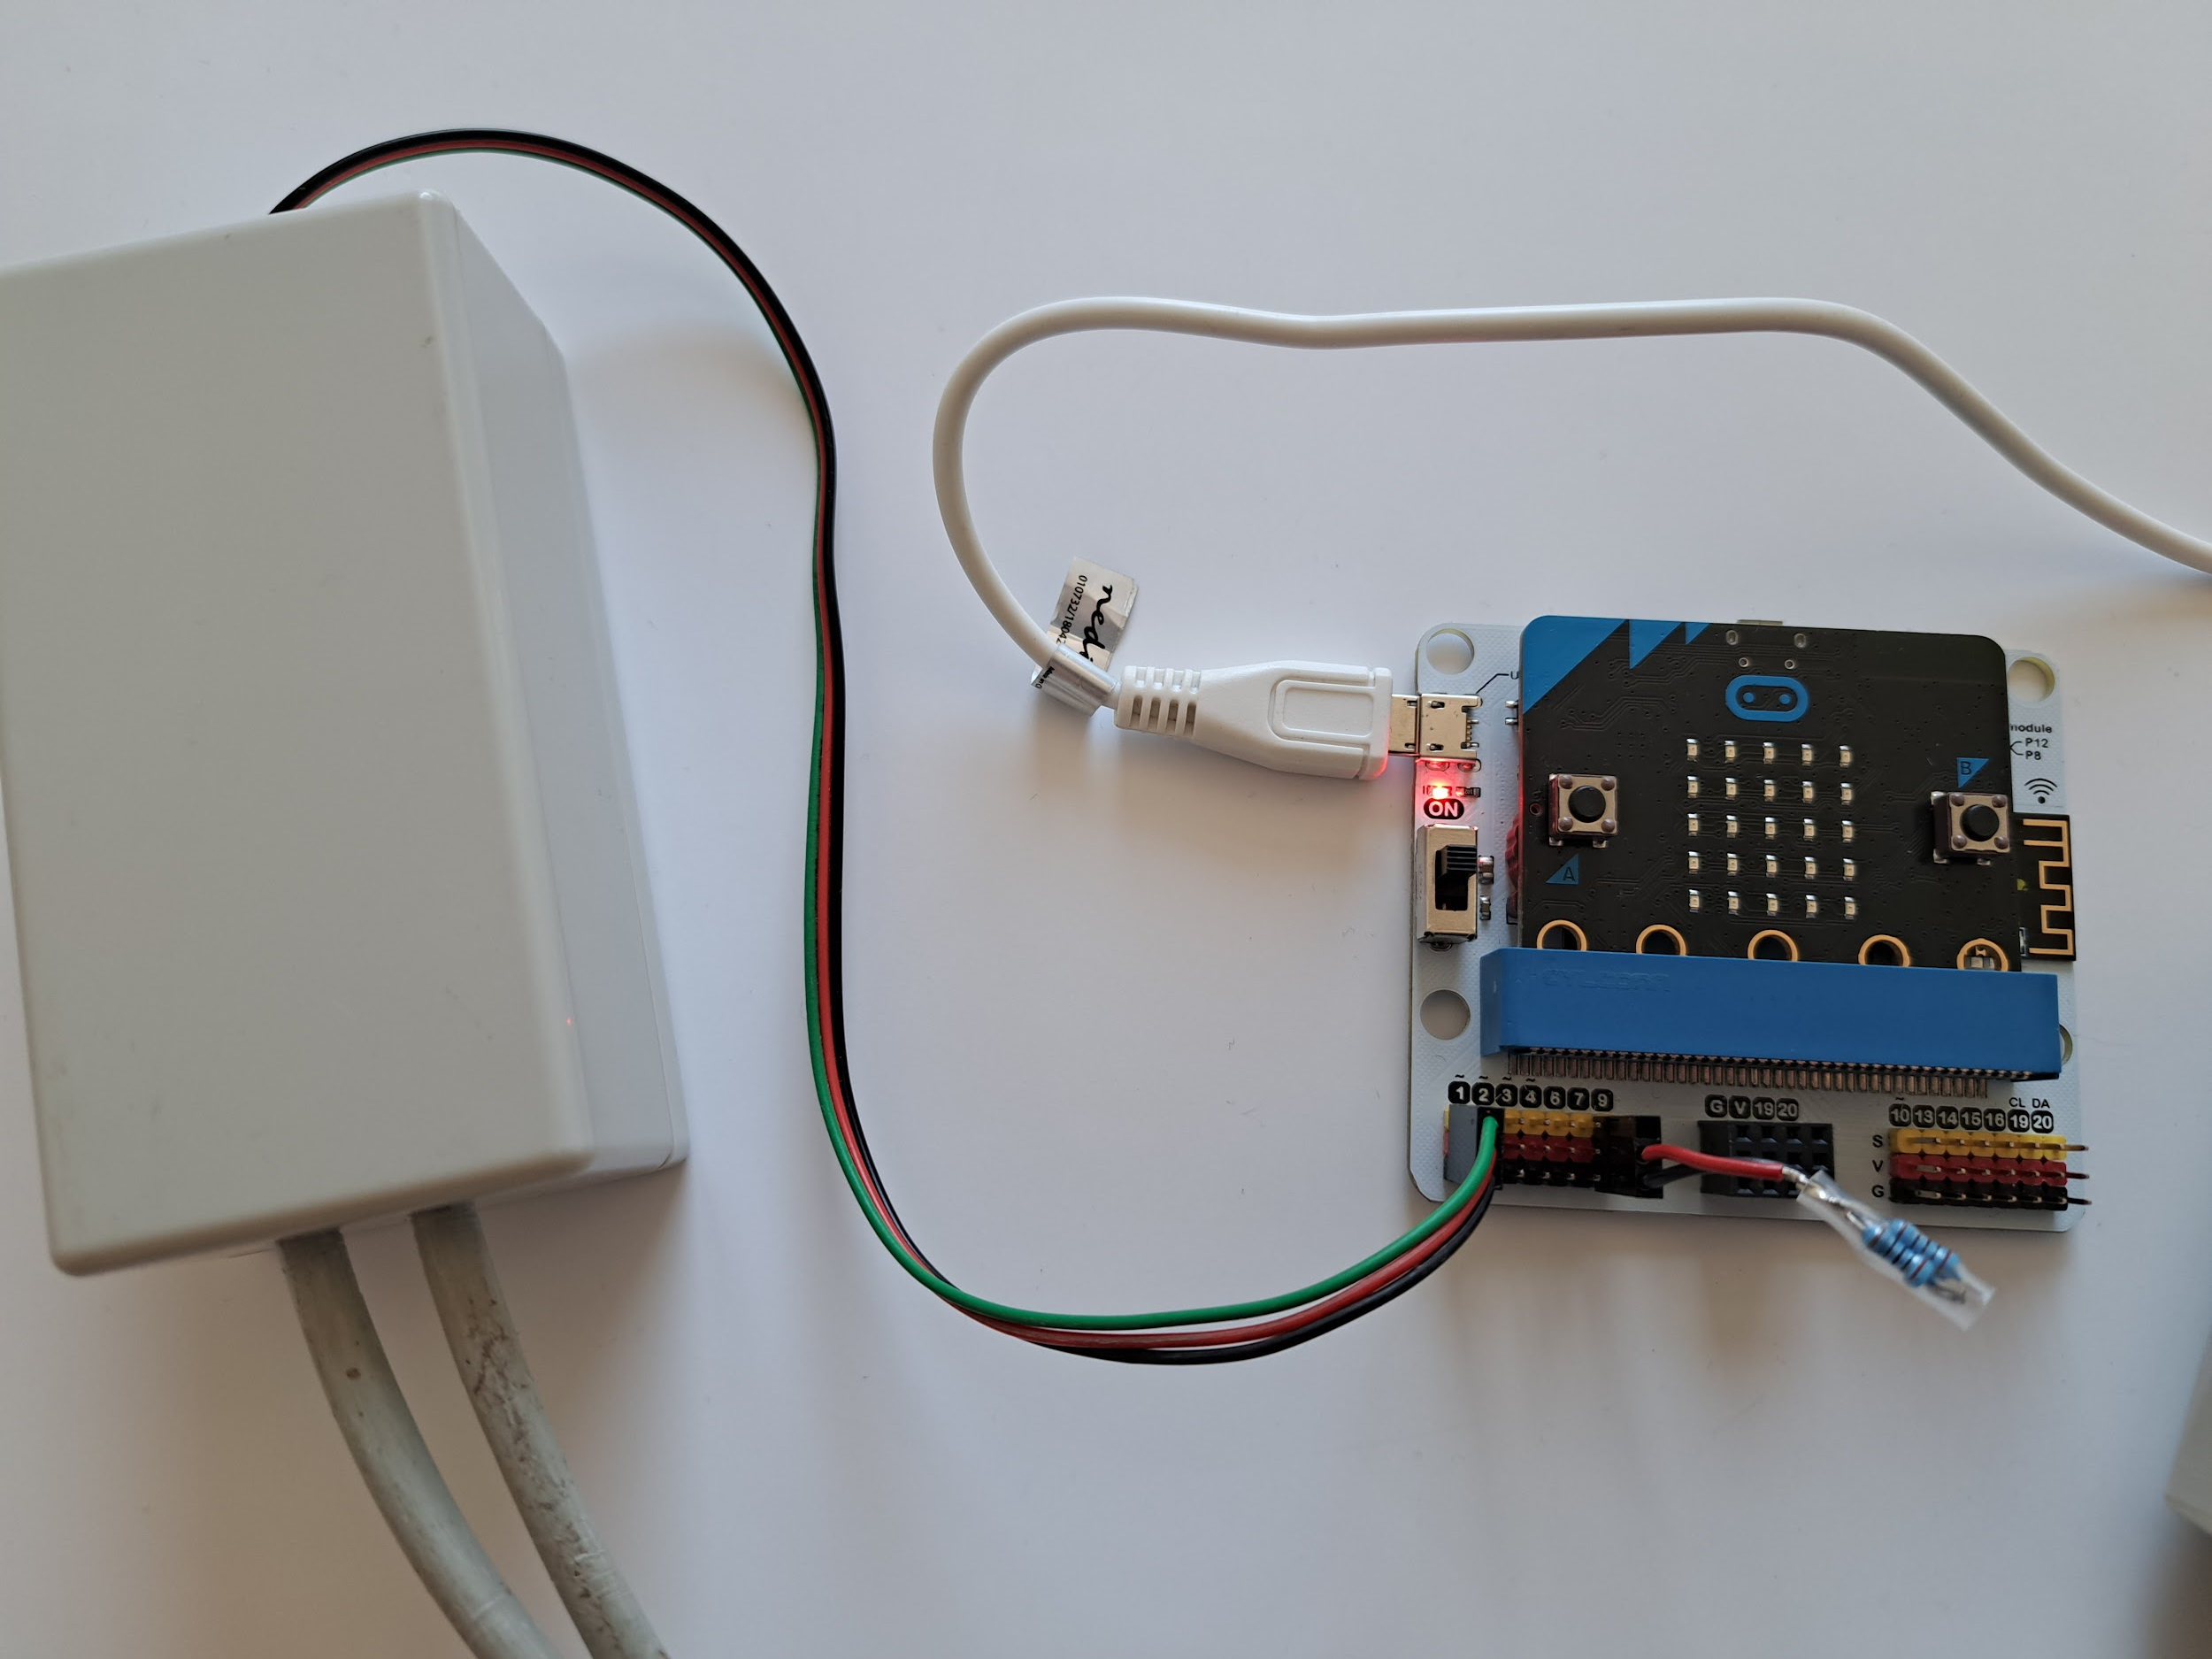
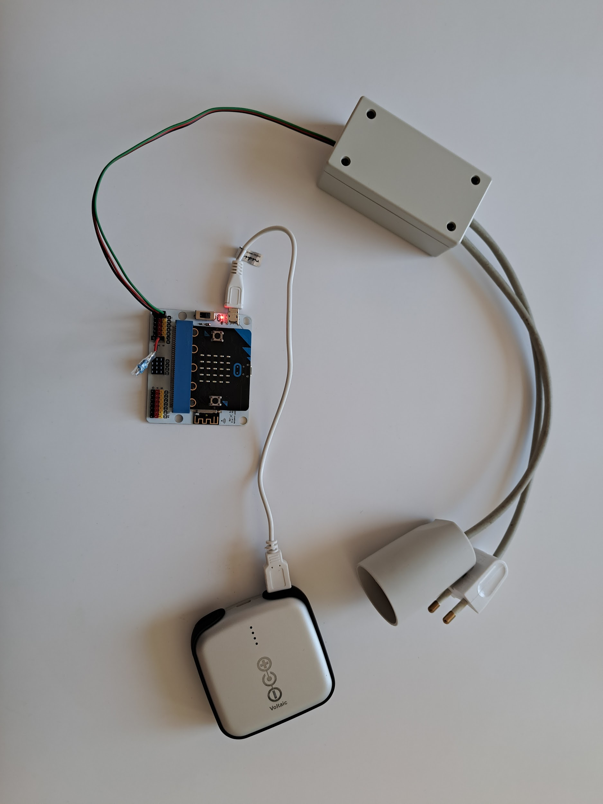
Assemble the IoT receiver
Receiver step 2:
Insert the relay into port 1 on your IoT board and the resistor into port 9 on your IoT board.
(Important! Make sure the connectors are facing the right way. The black and red leads must match the black and red markings on the board.)
Receiver step 3:
The finished receiver should look like the picture above
(Now connect your device to the relay socket and plug the relay into a power socket.)
Receiver step 1:
Insert a micro:bit and a power bank into an IoT board
(The small red lamp will light up to show that your IoT board is turned on – see picture above)
Notes:
Give every pair of students an IoT kit and an IoT device. Let them use the pictures in the student assignment or on slide 14-18. Alternatively, you can assemble the IoT kits with the students.
Introduce the students to the concepts: transmitter–receiver and relay

Slide 19
Programming and testing - Internet of Things
Assignment 1a
Notes:
The students should download the programs for the transmitter micro:bit and receiver micro:bit from the website. They should import these programs into Makecode for Micro:bits. It can be a good idea to review the programs with the students to be sure they understand the function of the various code blocks in the programs. (slide 19-20). Important: Hand out username, password and school ID for the students to write into the code block as seen below (more information - see resources)

Slide 20
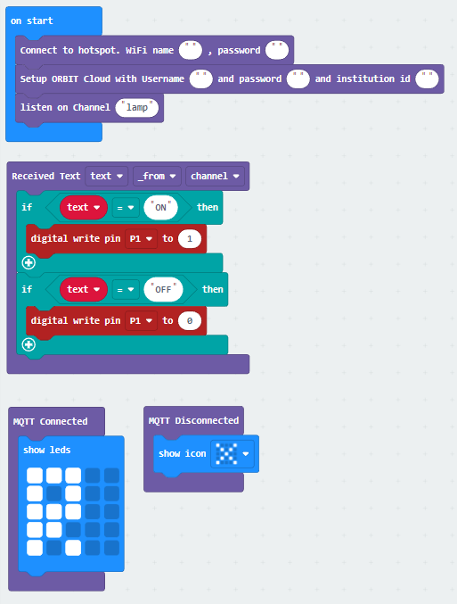
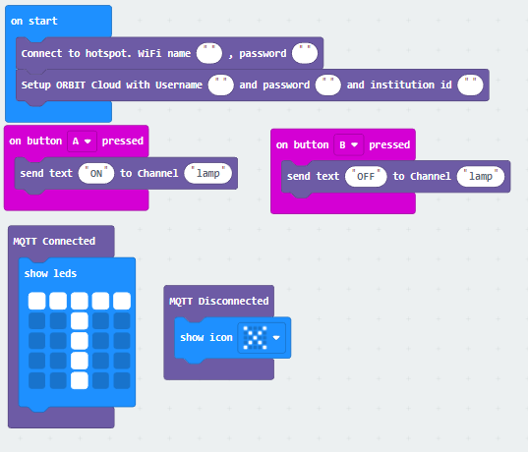
IoT-programming
Username:
Password:
School id:
Receiver program
Transmitter program
Notes:
The students should download the programs for the transmitter micro:bit and receiver micro:bit from the website. They should import these programs into Makecode for Micro:bits. It can be a good idea to review the programs with the students to be sure they understand the function of the various code blocks in the programs. (slide 19-20). Important: Hand out username, password and school ID for the students to write into the code block as seen below (more information - see resources)
The students should now download the two programs to the transmitter micro:bit and the receive micro:bit. They should download the file "receiver.hex" to the receiver micro:bit, and the file "transmitter.hex" to the transmitter micro:bit.
The students should test whether they can turn their IoT device on and off with their transmitter.

Slide 21
Data collection - Internet of Things
Assignment 1b
Notes:
Introduce the students to the ORBIT Cloud dashboard. They will require a username and password from you (more information - see resources). (Slide 21-22)
All student groups should use the channel name “lamp.” This is predefined in both the receiver and the transmitter program. All student groups are therefore sending data to the dashboard on the channel “lamp.”
The bar chart shows the sum of all the messages sent to the dashboard every time the students turn their IoT devices on and off.
If the students click on a channel name (below the bar chart), they will be able to see that the texts ON and OFF are sent every time they turn their IoT device on and off

Slide 22
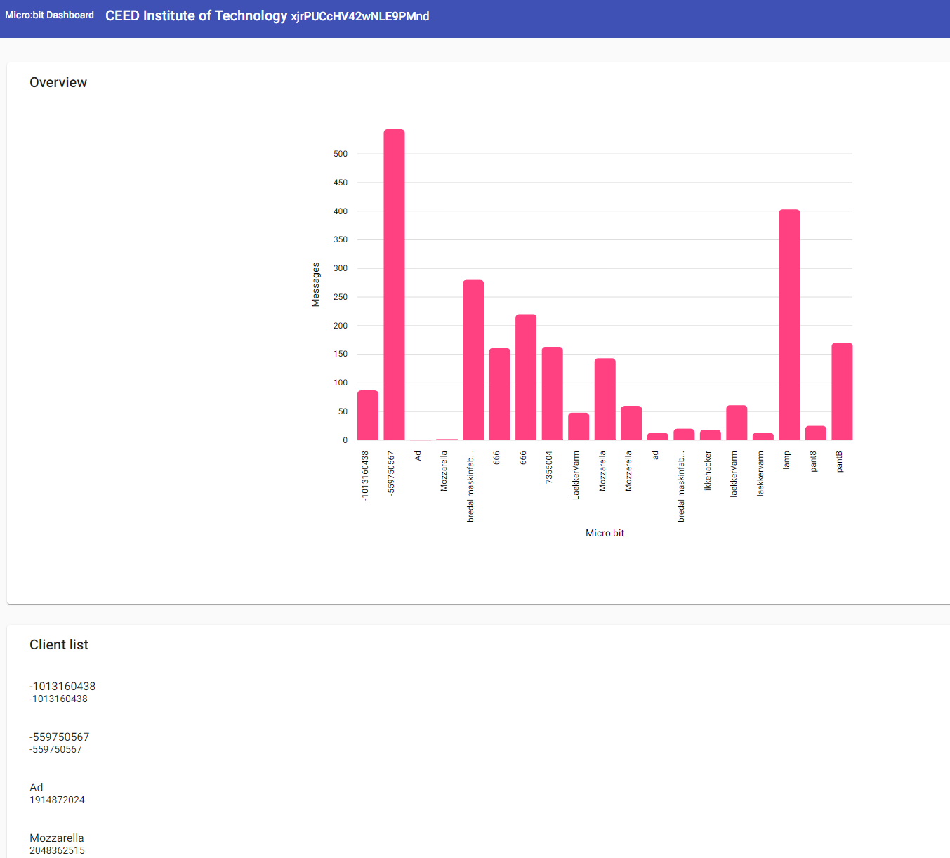
Data collection - Internet of Things
Everyone is transmitting on the channel “lamp”
The bar chart shows how many messages are being sent to each channel
Messages are sent every time a student team turns their IoT device on or off
Click on a channel below the bar graph to see the text messages that are sent (ON and OFF)
Notes:
Introduce the students to the ORBIT Cloud dashboard. They will require a username and password from you (more information - see resources). (Slide 21-22)
All student groups should use the channel name “lamp.” This is predefined in both the receiver and the transmitter program. All student groups are therefore sending data to the dashboard on the channel “lamp.”
The bar chart shows the sum of all the messages sent to the dashboard every time the students turn their IoT devices on and off.
If the students click on a channel name (below the bar chart), they will be able to see that the texts ON and OFF are sent every time they turn their IoT device on and off

Slide 23
New kanalnavn
Choose simple channel names!
IMPORTANT!
You must not tell your new channel name to any of the other student teams
Receiver program
Transmitter program
Notes:
The students should now change their channel name both in the receiver and the transmitter program. Each student pair should now have their own channel for sending data to the dashboard. To do this, they will need to change the name in the code block “channel name” and then download the programs again to the two Micro:bits. (slide 23)
Important! Student pairs should not tell others their new channel name.
It may be a good idea to tell the students to choose simple channel names that are easy for everyone to spell. (Avoiding tricky channel names that might prevent successful hacking)
Have the student pairs check out how the data collection on their new channels changes on the dashboard.

Slide 24
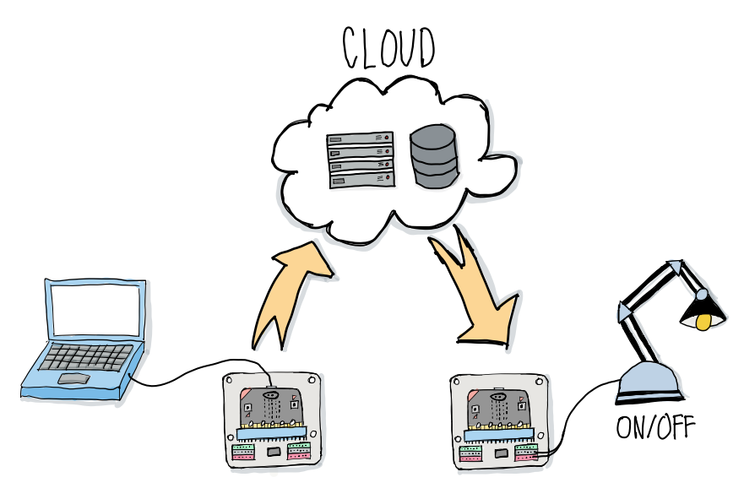
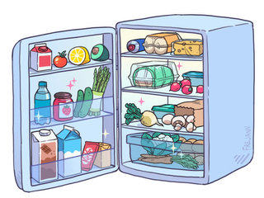
Classroom discussion
How does the Internet of Things work?
What could/should we use IoT for?
Notes:
Class discussion (slide 24)
Ask the students to explain how the Internet of Things works. They can use the illustration below as a starting point.
The Internet of Things describes devices that are connected to the Internet. Data is sent and received via built-in sensors. In this course, data is sent from the Micro:bit transmitter to a network server. The server then forwards the data to the Micro:bit receiver, which causes the IoT device to turn on and off.
Ask the students to reflect on what IoT can, or should, be used for.
Examples of IoT in use
A refrigerator connected to the internet that sends a message if the temperature gets too high/low
A washing machine connected to the internet that automatically turns on when power is cheapest
An electric car charger connected to the internet that only charges when the price of electricity is below a certain level

Slide 25
Hack your classmates
Assignment 2a
Notes:
The student pairs should now try to hack each other’s IoT devices. For this assignment they will need only their transmitter micro:bit (slide 25-26).
On the ORBIT Cloud dashboard, the student will be able to see each other’s channel names. Each group chooses one of these channel names and writes it into their transmitter program in Makecode. Finally, they download the program to their transmitter micro:bit.
The assignment is for students to figure out which student pair they have hacked. They can do this by seeing which IoT device they are turning on and off with their transmitter. If time permits, they can try several different channel names to hack and reveal the identity of more student pairs.

Slide 26
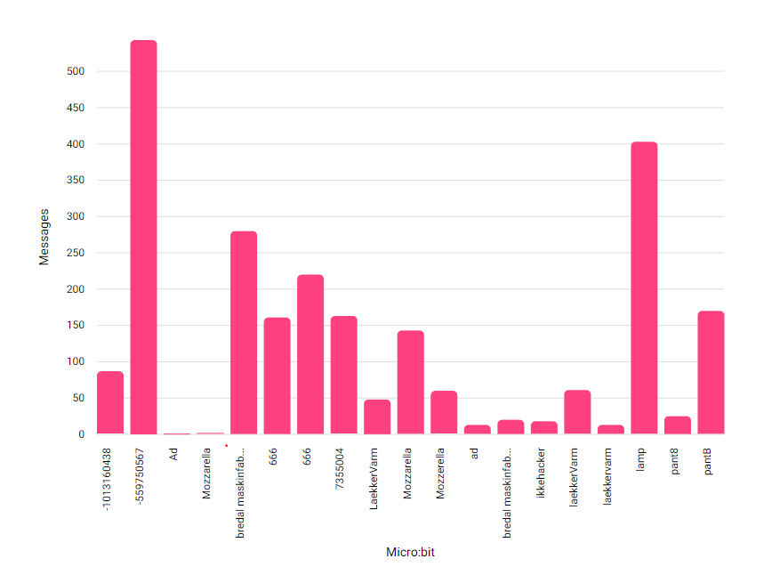
Hack your classmates You will need…
YOU NEED THE CHANNEL NAME OF ANOTHER STUDENT PAIR
THE CHANNEL NAME IS CHANGED IN THE PROGRAM FOR THE TRANSMITTER MICRO:BIT
Notes:
The student pairs should now try to hack each other’s IoT devices. For this assignment they will need only their transmitter micro:bit (slide 25-26).
On the ORBIT Cloud dashboard, the student will be able to see each other’s channel names. Each group chooses one of these channel names and writes it into their transmitter program in Makecode. Finally, they download the program to their transmitter micro:bit.
The assignment is for students to figure out which student pair they have hacked. They can do this by seeing which IoT device they are turning on and off with their transmitter. If time permits, they can try several different channel names to hack and reveal the identity of more student pairs.

Slide 27
CLASSROOM DISCUSSION
Did all the teams have their identity revealed?
What kind of hackers do the students become when they hack each other’s IoT devices?
How did the students feel about being hacked?
Do the students have any ideas on how to avoid being hacked?
How could you use hacking of an IoT device for a good cause?
White Hat Hacker
Black hat Hacker
Grey Hat Hacker
Red Hat Hacker
Hacktivist
Script Kiddie
Notes:
Class discussion based on the following questions: (slide 27)
Were all the identities unmasked (If necessary, write the pairs’ channel names on the board)
What kind of hackers are the students becoming when they are hacking each other’s IoT devices? (see slides in the teaching presentation)
How does it feel to be hacked?
Do students have any ideas on how to avoid being hacked?
Could hacking an IoT device be used for a good cause?

Slide 28
Protect yourselves from being hacked
Assignment 2b
Notes:
In this assignment the students should try to change their programs to make it harder for their classmates to hack them. For this they will need two new programs for the Micro:bit transmitter and receiver. They can download these from the website and import them to Makecode for Micro:bit (slide 28)

Slide 29
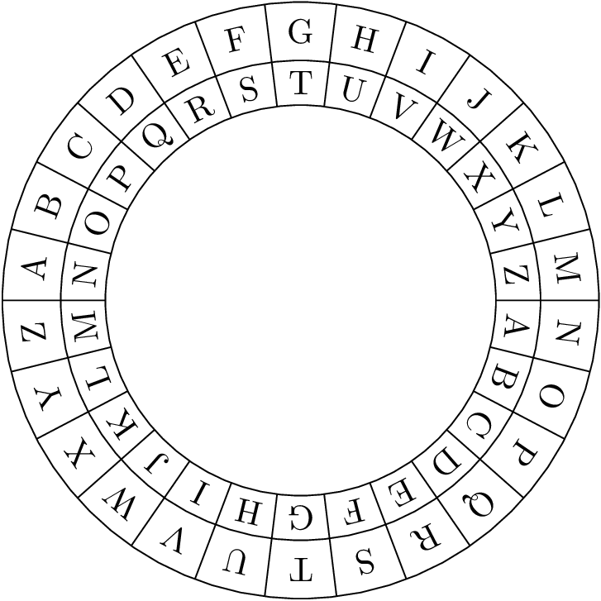
Caesar cipher - encrypting data
Substitution code
The data (the message) is changed according to the chosen shift factor
Named after the roman emperor Julius Caesar, who used it for his private correspondence
Try it out - Shift factor 5
ON → ?
OFF → ?
Notes:
Start by explaining the Caesar cipher to the students (slide 29)
The principle behind the protection in the two programs is a simple encryption of the data being sent in the IoT system. In this case we will be using the Caesar cipher. The encryption works through a substitution code in which each letter/number in the sent text is replaced by another letter/number, depending on the chosen ‘shift factor.’ This method is called after the Roman emperor Julius Caesar, who used this type of encryption for his private correspondence.
Example: With the shift factor 3, the text “ACD” becomes “DFG” when sent.

Slide 30
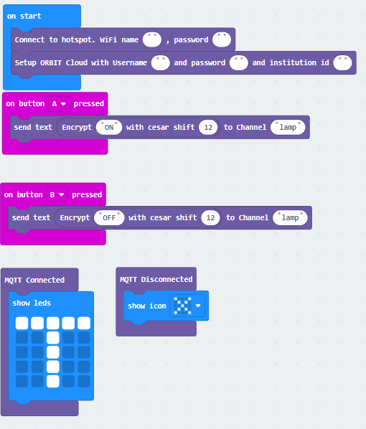
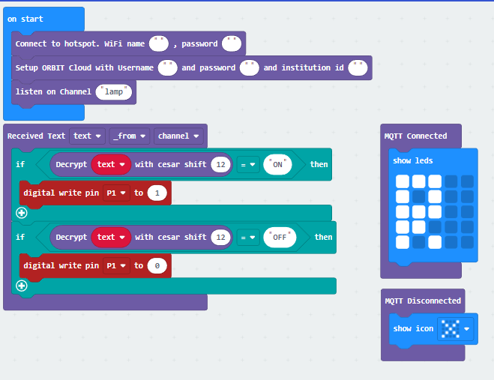
Protect yourselves from hacking
Username:
Password:
School ID:
Transmitter
Receiver
Caesar cipher wheel A-Z-a-z-1-9
Notes:
The student pairs now decide on a shift factor and write it into their transmitter and receiver program, then download the programs to their Micro:bits (slide 30)
Important! Remind the students to change the channel name (chosen in assignment 2A) and change the username, password and school ID (as in assignment 1A)
Optional: Students who want a harder assignment can change the text ON and OFF in the programs to a different text.

Slide 31
Protect yourselves from hacking
Username:
Password:
School ID:
Transmitter
Your new hacking method:
Click on another student group's channel name on the ORBIT Cloud dashboard (below the bar graph)
Notice which two text messages are being sent
Work out what shift factor they are using, by counting how many shifts you can count back to ON and OFF. (Hint: The Caesar cipher wheel goes A–Z–a–z–1–9)
Insert the channel name of the target group and the shift factor into your transmitter program and download it to your transmitter micro:bit.
Turn the transmitter ON and OFF to test whether you’ve hacked past the other team’s encryption
Notes:
The student pairs should now try to hack each other’s IoT devices once again (slide 31).
The new method for hacking is:
Click on another student group's channel name on the ORBIT Cloud dashboard (below the bar graph)
Notice which two text messages are being sent
Work out what shift factor they are using, by counting how many shifts you can count back to ON and OFF. (Hint: The Caesar cipher wheel goes A–Z–a–z–1–9)
Insert the channel name of the target group and the shift factor into your transmitter program and download it to your transmitter micro:bit.
Turn the transmitterON and OFF to test whether you’ve hacked past the other team’s encryption

Slide 32
Classroom discussion
Did you succeed in not being hacked?
Did you manage to hack other student teams despite the encryption?
In what situations could hacking be okay?
Can we now say anything in general about how to avoid being hacked?
Where in the IoT set up are there risks of being hacked?
Notes:
Class discussion (slide 32)
Did the students succeed in protecting themselves from being hacked?
Did the students succeed in hacking other student pairs despite the encryption?
In what situations could hacking be okay?
Is it now possible to say anything in general about what needs to be done to prevent being hacked?
Where in the IoT setup are there risks of being hacked?
Note: There is also a risk of being hacked as data is being sent to and from the server. In most cases the data would be encrypted, so it would not be easy for a potential hacker to make sense of the data. The server itself can also be hacked, and in such instances the data is often unencrypted. Hacking the server directly is therefore a much more attractive choice for the hacker.

Slide 33
Hack the teachers’ room
Assignment 3a
Notes:
The student pairs choose the IoT device they will use to hack the teacher’s room (slide 33)
They programme their transmitter and receiver Micro:bit (as in assignment 1A)

Slide 34
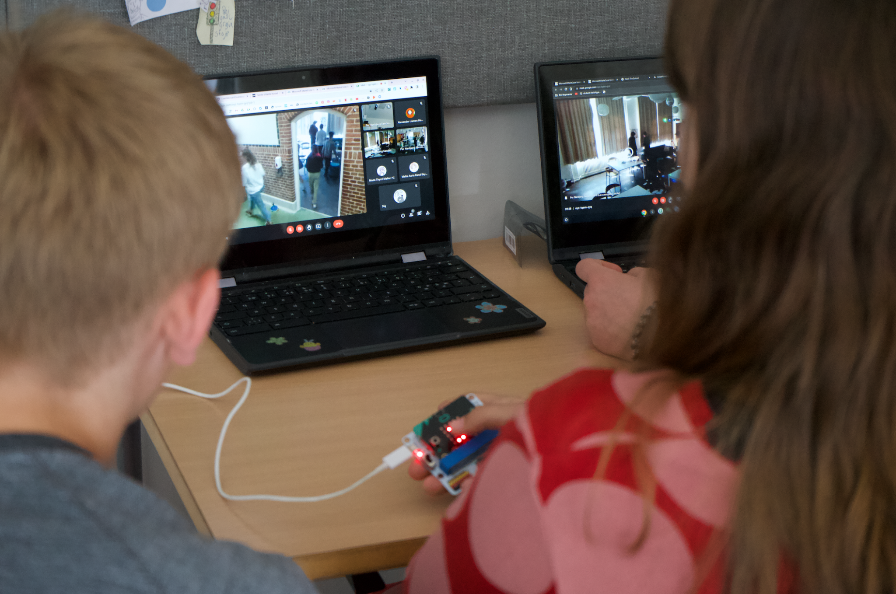
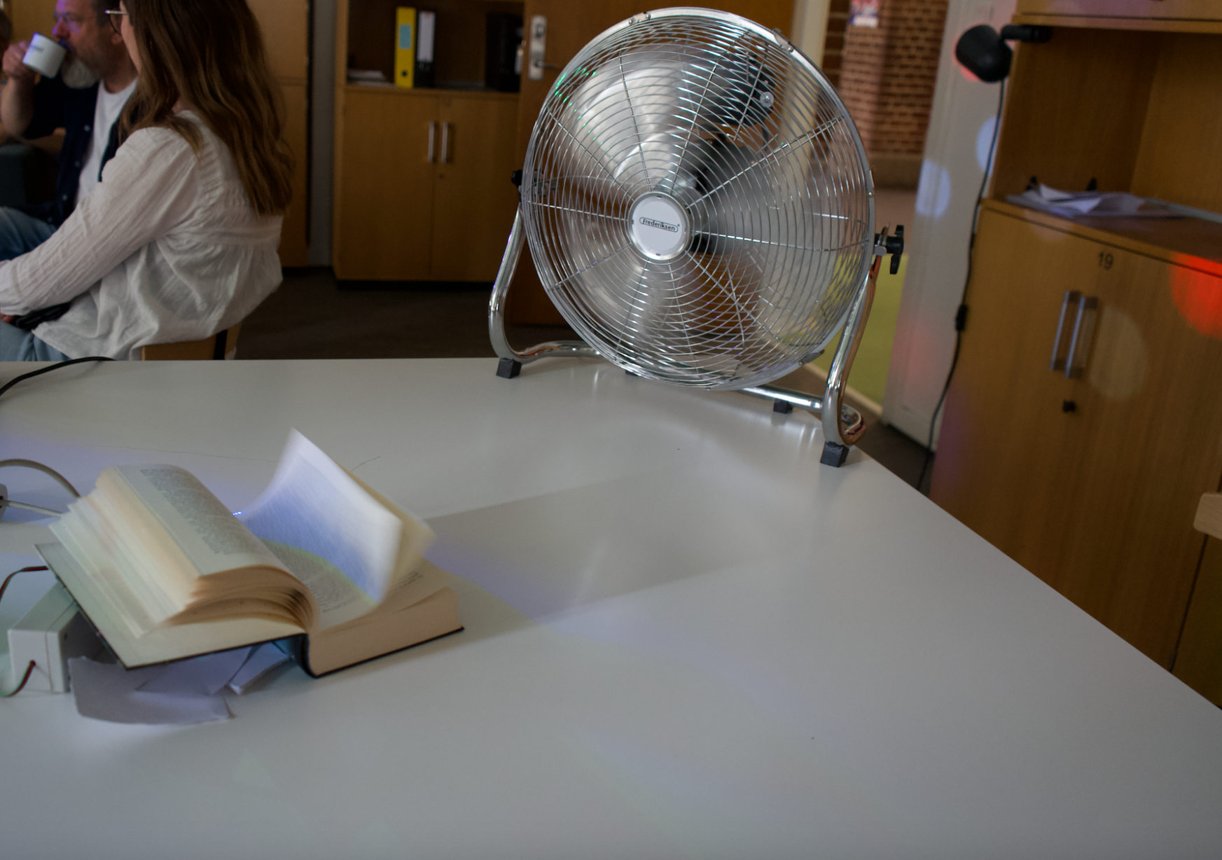
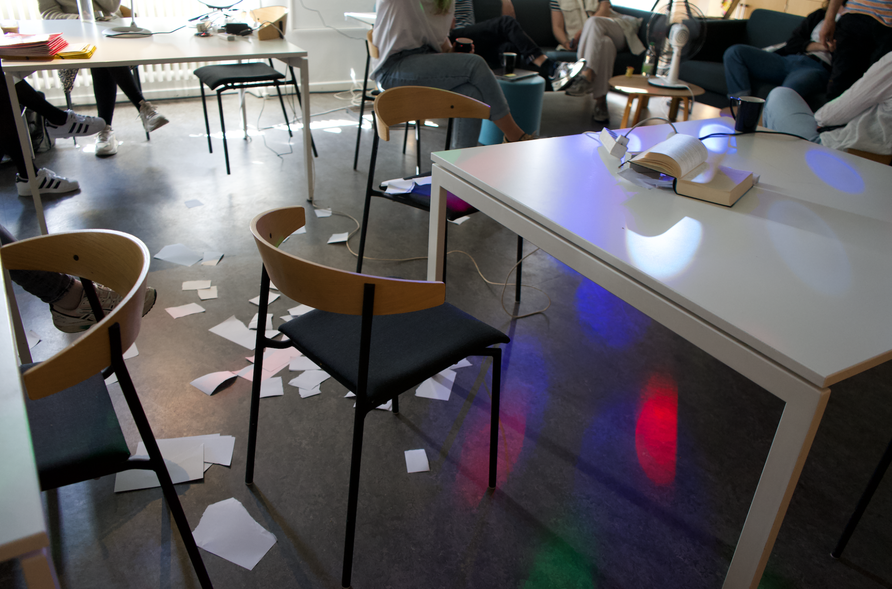
Hack the teachers’ room
THE CLASSROOM- THE IoT Transmitter
THE TEACHERS’ ROOM - THE IoT RECEIVER
Notes:
They take the receiver part of the IoT set up to the staffroom and set it up in the desired location (slide 34)
At teachers break time, the student pairs start hacking the IoT devices by turning the transmitter Micro:bit ON and OFF. They can follow the teachers’ reactions in the staffroom on the blackboard showing the livestream

Slide 35
CLASSROOM DISCUSSION
You have just hacked the teacher’s room as a prank on them
Can you imagine hacking the teachers’ room to help the them, or to make their job easier?
How could you do that?
Notes:
Classroom discussion (slide 35)
You have just hacked the staffroom as a practical joke on the teachers. Can you imagine hacking the staffroom to help the teachers, or make their job easier? How might you go about doing that?

